Slide 1
1/4
Feedback 1 Report to Sato San
Feedback divided into below n=3 areas
1.Washing Mc App
2.Traceability Dashboard
3. IT Connectivity
08 Dec’23

Slide 2
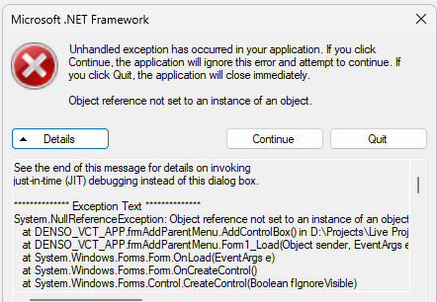
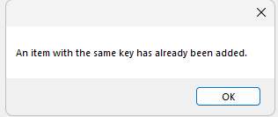
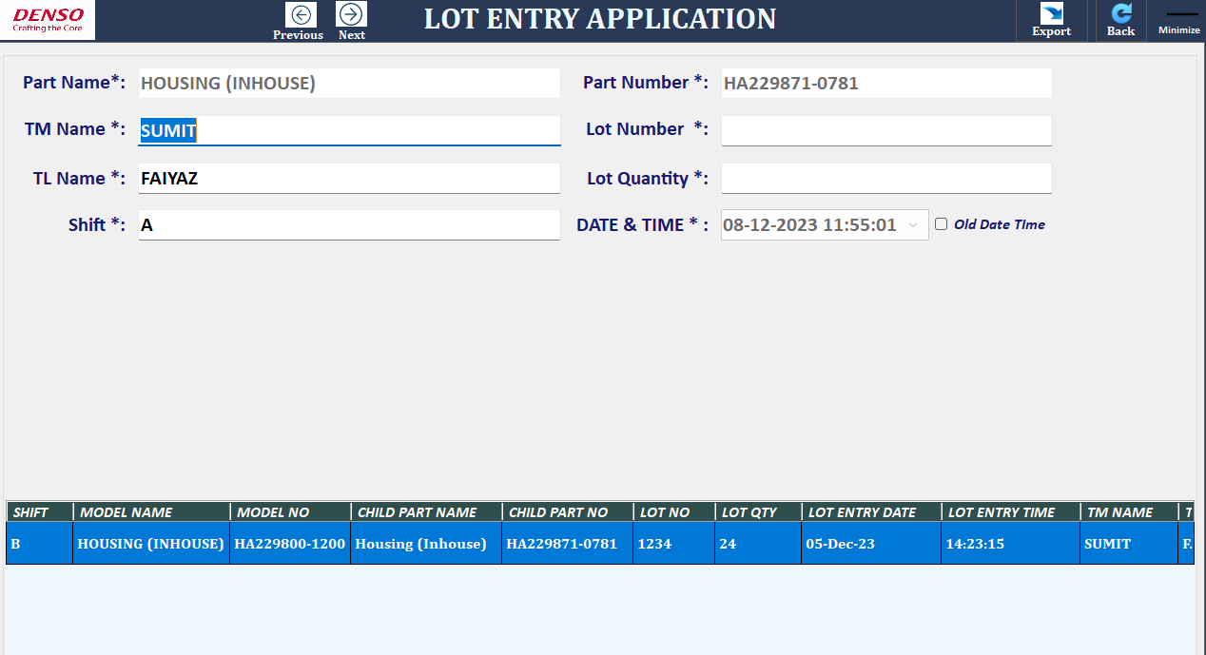
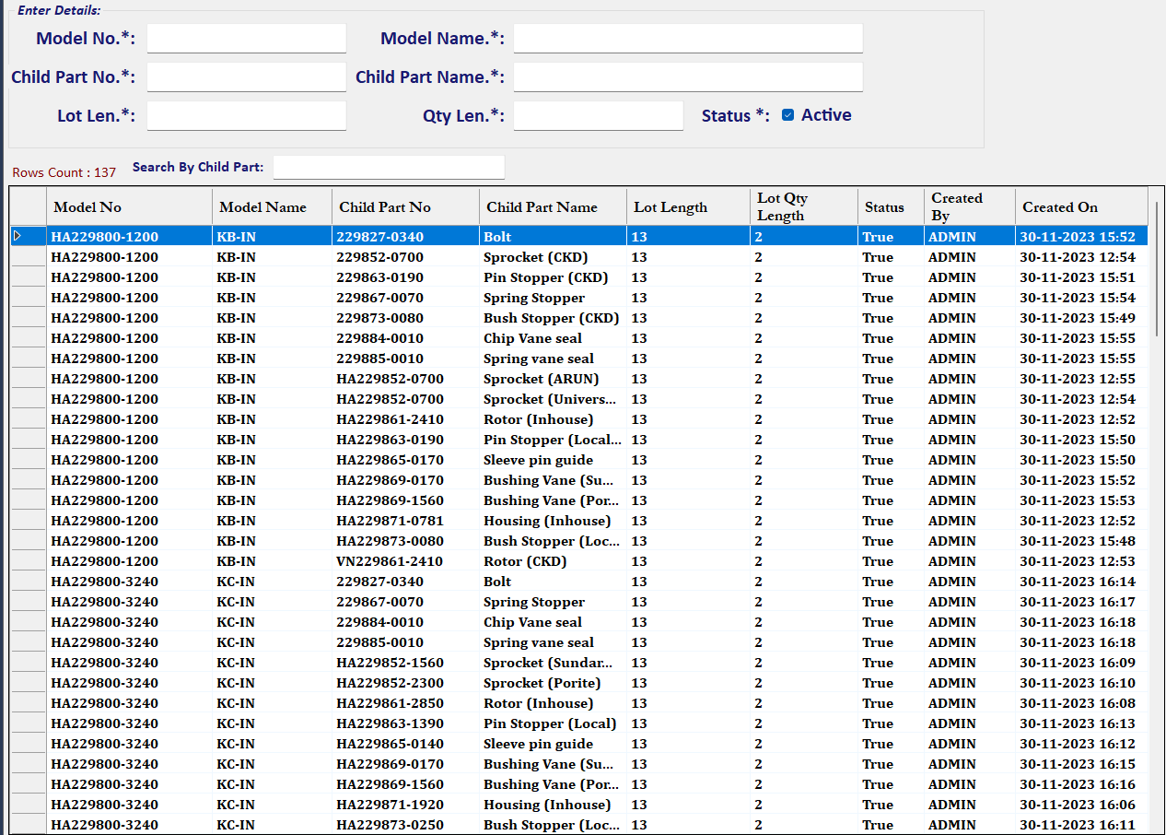
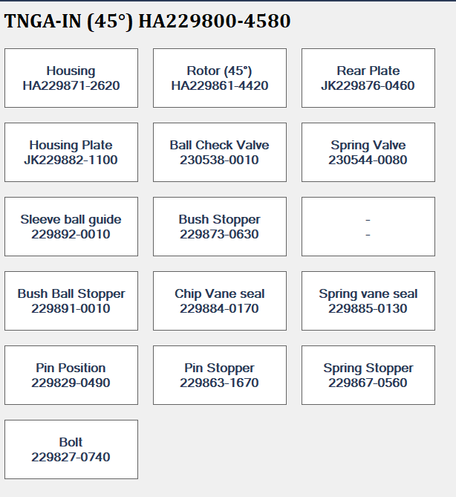
1.Washing Mc App
2/4
Sharing to Sato _8 Dec’23
S/n | Point | Explanation Image | Action | Status
1. | During App opening ,Error coming |  | Sato backend side solved this error | Closed
2. | During App opening ,Error coming |  | Sato backend side solved this error | Closed
3. | Lot entry row screen not good visualization. Row layout need to change to see other info. Row Height size high→ Keep optimum |  | OK, We will Check provide the solution till Till Thursday(14-12-23). | Closed
4. | Part forward backward issue with arrow symbol |  | OK, We will Check provide the solution till Thursday(14-12-23). | Closed
5. | In model master created date should be on date it is modified (to keep change history). |  | OK, We will Check provide the solution till Thursday(14-12-23). | Closed
6. | If some child part info deleted then box not deleting <refer image> |  | Comments: This is the Odring based entry in Model master so in need to try to fix with any sequence no. OK, We will Check provide the solution till Thursday(21-12-23). | Open
7. | Old Lot entry complete deleting instead of modify entered old value | - | OK, We will Check provide the solution till Thursday(14-12-23). | Open
8. | Step 2 lot QR code lot entry pls show by scanner |  | Ok, When we will do the gamba then will show you scanner demo.

Slide 3
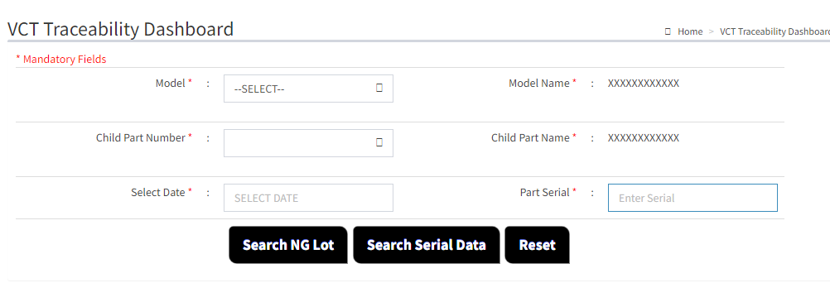
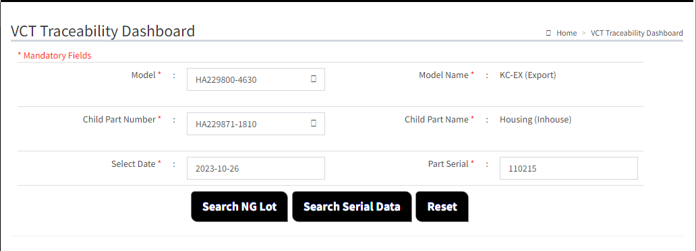
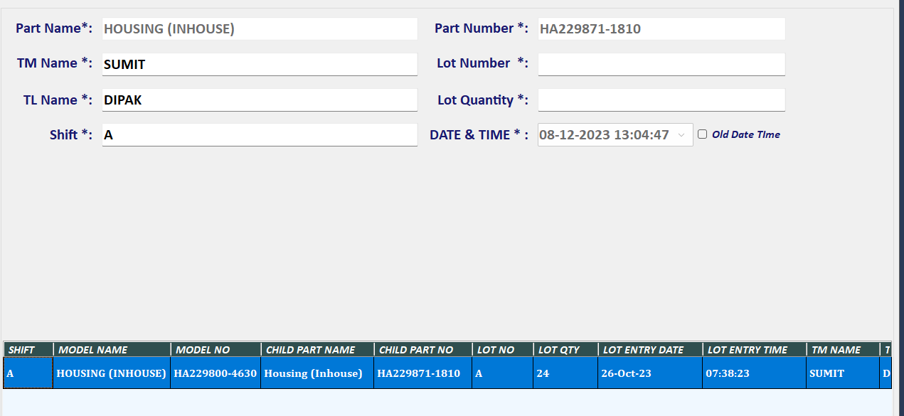
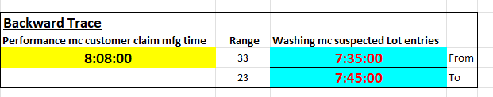

2.Traceability Dashboard
3/4
Sharing to Sato _8 Dec’23
S/n | Point | Explanation Image | Action | Status
1. | Part serial no. should start from 2 not 1 as target line is Line 2. (Total 6 Digit) |  | This provision is already given in scheduler setting file where it can manage line no data. | Closed
2. | Dashboard not working. What to take action Difficult to verify . |  | Now it is showing fixed by last Friday, Date time was not in correct in the file therefore data was not showing perfectly we will try to manage it in our side but we have already requested don’t manual edit the file during testing take the fresh file . | Close
 |  |  |  | Close
 |  |  |  | Close
 |  |  |  | Close
6. | Performance Data report into server |  | We have to make the new Report so OK, We will Check provide the solution till Thursday(14-12-23). | Open
7. | Performance data into server confirmation log report. |  | OK, We will Check provide the solution till Thursday(14-12-23). | Open
Dashborad did not show any results
Lot Entry
Time Limits
FG S/n

Slide 4
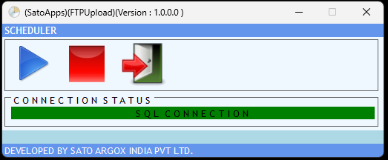
3. IT Connectivity
4/4
Sharing to Sato _8 Dec’23
S/n | Point | Explanation Image | Action | Status
1. | How to confirm from Performance mc CSV are going to server means Scheduler app working or not efficiently |  | This is the first the step need to check with your ISD team, they will analyze it background issue like network, application status etc. then second step they will report the issue to SATO. | Open
2. | How to trigger this scheduler in Performance mc .PRD team can skip. |  | This is the first the step need to check with your ISD team, they will analyze it background issue like network, application status etc. then second step they will report the issue to SATO. | Open
3. | In Washing mc lot entry if data not saved or going to server what will come and how to correspond this issue. |  | This is the first the step need to check with your ISD team, they will analyze it background issue like network, application status etc. then second step they will report the issue to SATO. | Open
4. |  |  |  | Open
5. |  |  |  | Open
6. |  |  |  | Open
7. |  |  |  | Open
During genba actual use, more improvement support we request to Sato

